Slide 1
Hashing

Slide 2
Introduction
Why hashing is needed?
Structure | Array | Linked list | BST
Add first | O(n) | O(1) | O(height)
Add last | O(1) | O(1) | O(height)
Search | O(n) | O(n) | O(height) -> O(logn)
Remove | O(n) | O(1) | O(height)
What we have to do if requirements in search and remove operations needs higher efficiency?
Searching in a smaller set is more efficient than those in a lager set.
The “Divide and Conquer principle” is applied.
Hashing

Slide 3
Introduction…
Hashing: Partitioning a large set into subsets
4
3
2
1
0

Slide 4
Learning Outcomes
LO7.1 Explain the concept of "hash". Define concepts hash function and hash table and their application.
LO7.2 Demonstrate the types of hash functions: Division, Folding,...
LO7.3 Explain the collision and collision-handling.
LO7.4 Explain the open addressing method for collision-resolution: linear and quadratic probing.
LO7.5 Explain the chaining method for collision-resolution: separate chaining and Coalesced chaining.
LO7.6 Define perfect hash function and extendible hashing.

Slide 5
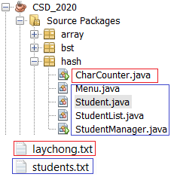
Contents
1- Basic of Hashing
2- Common Hash Functions
3- Data storage of a hash structure
4- Common methods of a hash table
5- Collision Resolution
6- Load Factors, Rehashing, and Efficiency
7- Deletion
Introduction:
8- Perfect Hash Functions - Definition
9- External Hashing- Hash Functions for Extendible(extensible) Files
10- Hashing in java.util
Your works: Re-implement the given project

Slide 6
1- Basic of Hashing
What is hashing? → A process in which a large data set will be partitioned into some data subsets.
What is the tool for hashing? → hash function
What will hash function do? → This function is constructed by implementer which accepts input data ( whole initial data or a chunk of initial data or memory address of data) and an unique index is it’s output → index of a subset.
Who will implement hash function? → Hashing implementer.
Data storage is used in hashing is called as hash table. Number of subsets is called as table-size.
What are hashing used for?
Storing group of objects supporting search effectively.
Adding security to content in cryptography (read yourself)

Slide 7
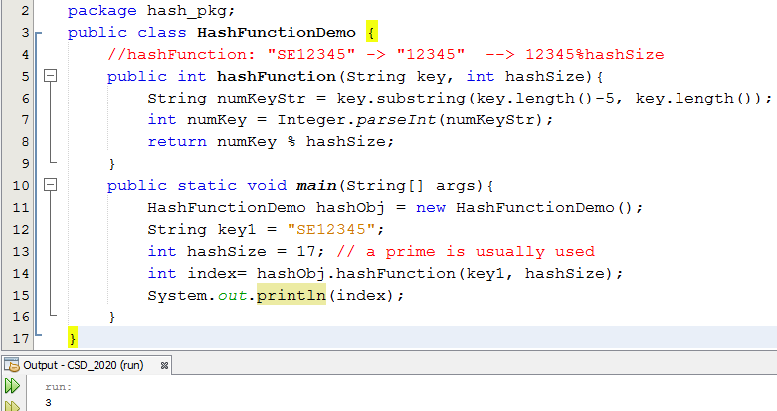
1- Basic of Hashing …
Example: A hash function

Slide 8
2- Common Hash Functions
An object is usually identified using a key (ID), a nunber or a string
Hash function (h) transforms a particular key (K) into an index of a subset.
h
Object’s Key
Integer (index of a subset)
If the hash function gives the same index on different objects then they belong to the same subset.
If h transforms different keys into different numbers, it is called a perfect hash function → A subset contains ONE element only ← Ideal case.
To create a perfect hash function, the table has to contain at least the same number of positions as the number of elements being hashed.

Slide 9
2- Common Hash Functions…
To get an integer as the output of a hash function, an integer expression must be used. In integral operators, the operator modulo (%) is usually used.
hash
Object’s Key
integer
Convert string key to integer, N
Return N % tableSize

Slide 10
2- Common Hash Functions…
All operations on the hashing storage must rely on hash function.
4
3
2
1
0
Hash
O(1)
Object’s Key
integer
Cost of an operation = O(1) + Cost of operation on a specific subset.

Slide 11
2- Common Hash Functions
The division method is the preferred choice(%, modulo).
TSize =sizeof(table), as in h(K) = K mod Tsize→(K%Tsize)
Folding method: h(K) = sum of parts mod Tsize
Ex: K= 123-45-6789 → sum 3 parts:123 + 45 + 6789= 6957
→ h(K)=6957 mod TSize
Ex: K= 123-45-6789 → Sum 5 parts:12 + 34+56+78+9 = 189
Mid-square method :
Ex: TSize= 1024= 2¹⁰, K= 3121 → K²=9 740 641
K²= 1001010 0101000010 1100001 → h(K) = 0101000010₂ = 32
Extraction method: Only a part of the key is used to compute the address
Ex: K = 123-45-6789, h(K) = 1289 mod Tsize
SE123456 → 123456, SE56 → number?
Radix transformation method:
K = 345₁₀ → 423₉ ➔ h(K) = 423 mod Tsize ( =23 if Tsize=100 )
Hash table designer will decide an approach for hash function

Slide 12
3- Data Storage of a Hash Structure
Central storage using an array
All data objects are stored in an array
An array for all subsets
A table entry for ONE data object
A table entry for some objects ← Bucket hashing
Separate chaining: Each subset has it’s own individual storage ← Separate chaining hashing
Central storage using a file in external disk
All data objects are stored in a file ← External/ extendible hashing

Slide 13
3- Data Storage of a Hash Structure…
Common Arrays and Hash tables
In a common array, all data objects are identified using unique indices and stored in a consecutive blocks.
In a hash table, hash function will determine the index each stored data object.
→There can be empty entries in the hash table.
→The structure of a hash table entry contains information:
Used?
Data object
Link to the next object

Slide 14
3- Data Storage of a Hash Structure…
Data
index
Storage
K1, val1
K2, val2
K3, val3
…
Kn, valn
0
1
2
h
3
4
5
6
7
…
…
…
…
Structure of a hash table entry:
m-1
Used?
Data object
Link to the next object

Slide 15
4- Common methods of a hash table
Method | Purpose
get (key) | Getting value of a given key
put (key, value) | Add a data object to hash table
remove (key) | Remove a data object
size() | Number of stored data objects
isEmpty() | Checking the hash table is empty or not
keySet() | Getting key set
values() | Getting set of values

Slide 16
5- Collision Resolution
Collision: A situation in which 2 distinct inputs but the hash function gives the same output → Same position
Common methods are used as solutions:
Open Addressing Method– Dò tìm vị trí kế cận
Chaining Method/ Coalesced chaining– băm theo nhóm
Bucket Addressing: Một phần tử của bảng chứa vài objects
Ex:
K1= 1025 → h(K1) = 1025%100 = 25
K2= 125 → h(K2) = 125%100 = 25
K3= 25 → h(K3) = 25%100 = 25

Slide 17
5- Collision Resolution…
Case: Central Storage
Open Addressing Method: when a key collides with another key, the collision is resolved by finding an available table entry other than the position (address) to which the colliding key is originally hashed. Common methods:
if no collision, using h(k).
If collision, using h’(k) = h(k) + f(i): i varies from 1, 2, 3, 4, 5,…. until an empty position is found
f(i): probing function. It can be linear (bậc 1 – dò tuyến tính- simplest method) or quadratic function (bậc 2 – dò bậc 2)

Slide 18
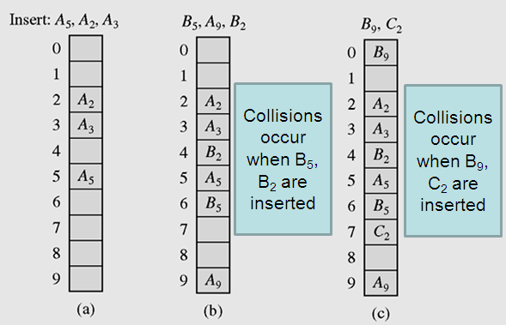
5- Collision Resolution…
Case: Central Storage
Open Addressing Method:
Linear Probing, p(i) =i, h’(K) = (h(K) + i) mod TSize
i= 1, 2, 3…
Resolving collisions with the linear probing method. Subscripts indicate the home positions of the keys being hashed.

Slide 19
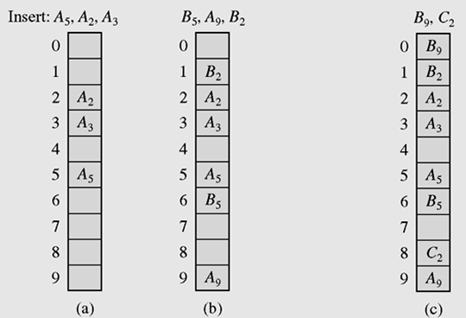
5- Collision Resolution…
Case: Central Storage
Open Addressing Method:
Quadratic method: p(i)= ± i², h’(K) = (h(K) ± i²) mod TSize
Insert B₉
→Collision
probe: i=1
h(9+1)=h(10)=0 →OK
Insert C₂
→Collision
probe: i=1
h(2+1)=h(3)=3 →No OK
h(2-1)=h(1)=1 → No OK
probe: i=2, i²=4
h(2+4)= 6 → No OK
h(2-4), -2<0 → No OK
probe: i=3, i²=9
h(2+9)= 1 → No OK
h(2-9)= 2-9<0→ No OK
probe: i=4, i²=16
h(2+16)= 8 → OK
Insert B₅
→Collision
probe: i=1
h(5+1)=h(6)=6 →OK
Insert B₂
→Collision
probe: i=1
h(2+1)=h(3)=3 →No OK
h(2-1)=h(1)=1
OK
Using quadratic probing for collision resolution: h’(K) = (h(K) ± i²) mod 10

Slide 20
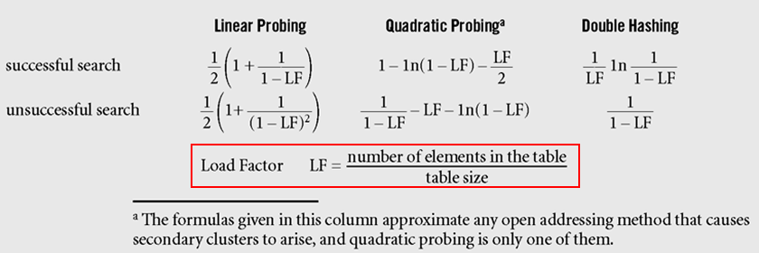
5- Collision Resolution…
Case: Central Storage
Open Addressing Method: Evaluation:
Formulas approximating, for different hashing methods, the average numbers of trials for successful and unsuccessful searches (Knuth, 1998)

Slide 21
5- Collision Resolution…
Chaining Method
Keys do not have to stored in table itself, each position of the table is associated with a linked list or chain of structures whose info fields store keys or references to keys
This method is called separate chaining, and a table of references (pointers) is called a scatter table (bảng phân phối)

Slide 22
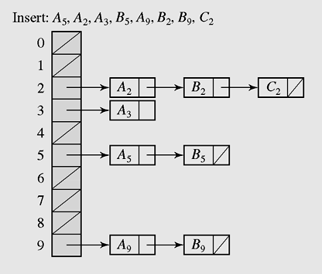
5- Collision Resolution…
Separate Chaining
Method
h(K) → index of a linked list of elements having the same value of hash function.
K→ h(K) → index →traverse the appropriate list to find the element having this key.
N objects are partitioned into M subsets → Average size of a subset: N/M. A subset is a list → Search operation has complexity of O(N/M)
In chaining, colliding keys are put on the same linked list
(The most flexible hash format)

Slide 23
5- Collision Resolution…
Coalesced chaining- Central array
A version of chaining called coalesced hashing- băm hợp nhất- (or coalesced chaining) combines linear probing with chaining
An overflow area (vùng tràn, hầm chứa) known as a cellar can be allocated to store keys for which there is no room in the table

Slide 24
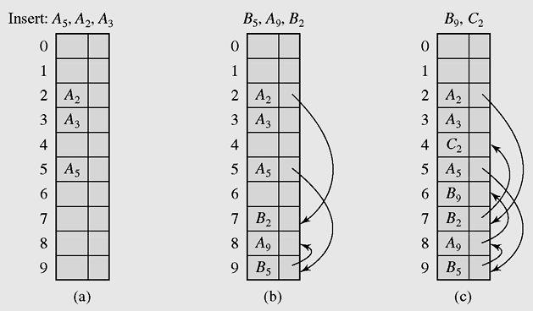
5- Collision Resolution…
Coalesced chaining
Index of next element in the same group
Default:
-1
7
9
8
Coalesced hashing puts a colliding key in the last available position of the table

Slide 25
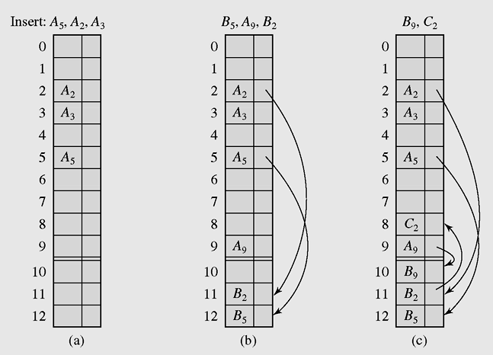
5- Collision Resolution…
Coalesced chaining
Main area
When cellar is full, inserted element will be put to the main region
Cellar: overflow area
Mechansm: bottom-up
Coalesced hashing that uses a cellar

Slide 26
5- Collision Resolution…
Bucket Addressing Method
To store colliding elements in the same position in the table can be achieved by associating a bucket with each address
A bucket (khối) is a block of space large enough to store multiple items

Slide 27
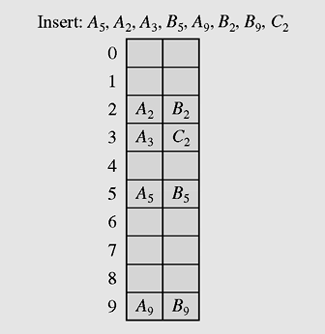
5- Collision Resolution…
Bucket Addressing
bucket
Insert C₂
→ Collision
Use linear probing
Bucket 3 containing a space
Insert C₂ to bucket 3
Collision resolution with buckets ( bucket=2)
and linear probing method

Slide 28
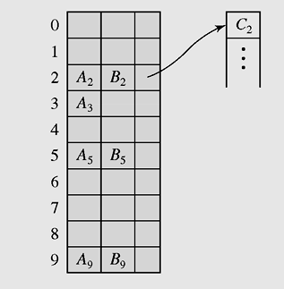
5- Collision Resolution…
Bucket Addressing
bucket
Reference to separate overflow area
Collision resolution with buckets and overflow area

Slide 29
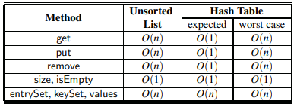
6- Load Factors, Rehashing, and Efficiency
Array-based Hash table
Load factor (hệ số tải)
λ= n/N
n: number of stored data object N: Table size
Recommendation: λ <0.9. By default in Java: λ =0.75
Higher load factor, higher overhead for collision resolution
When λ > pre-defined factor, the hash table is considered FULL
Rehashing: Creating a new hash table from a full hash table:
New larger storage is allocated → λ decreases
Collision reduces
Efficiency:
(Figure 10.2 in the textbook )

Slide 30
7- Deletion
Begin
Deleted data (k)
h(k)
index
Search and delete k
Group contains k
End

Slide 31
7- Deletion…
Structure and collision resolution of the hash table will decide the way by which its elements are deleted. They can be
Linear search for deletion
Linear search to locate the linked list of the subgroup then delete an element in this linked list.
Linear search to locate the subgroup then delete an element in this subgroup, update references to next elements in the same subgroup.

Slide 32
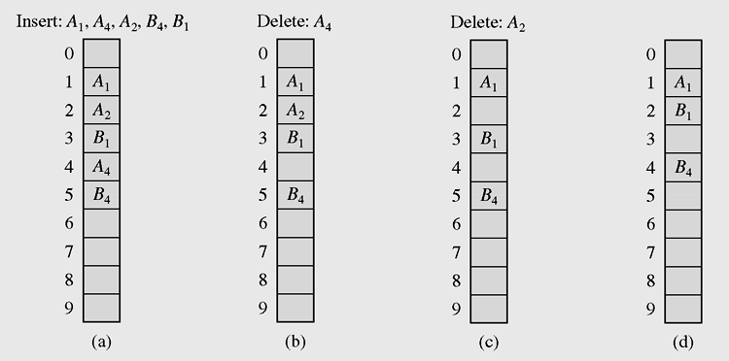
7- Deletion…
H’(k) = H(k) + i
Update locations
Delete A4
Linear search in the situation
where both insertion and deletion of keys are permitted

Slide 33
8- Perfect Hash Functions
A hash function is called as perfect when it transforms different keys into different numbers→ A subset contains ONE element only ← Ideal case.
Expectation:
If a function requires only as many cells in the table as the number of data so that no empty cell remains after hashing is completed, it is called a minimal perfect hash function → hàm băm hoàn hảo tối tiểu → Ít xung đột nhất
Methods: (Read by yourself)
Richard J. Cichelli’s methode
FHCD’s method

Slide 34
9- External Hashing
Hash Functions for Extendible Files
File=table.
Expandable hashing, dynamic hashing, and extendible hashing methods distribute keys among buckets in a similar fashion
Data → h(Data) → index → buckets[index]
The main difference is the structure of the index (directory)
In expandable hashing and dynamic hashing, a binary tree is used as an index of buckets
In extendible hashing, a directory of records is kept in a table

Slide 35
9- External Hashing …
Extendible hashing accesses the data stored in buckets indirectly through an index that is dynamically adjusted to reflect changes in the file
Extendible hashing allows the file to expand without reorganizing it, but requires storage space for an index
Values returned by such a hash function are called pseudokeys

Slide 36
9- External Hashing…
It is commonly used in database files, file = hash table
Record = <key, value>
A bucket contains some records, a bucket has a unique index and new buckets can be created.
Bucket indexes are stored in an distinct area and it is called as directory→ file = {directory, bucket1, bucket 2, ……}
Extendible hashing allows the file to expand without reorganizing it, but requires storage space for an index
Multi-level / extendible hashing can be used
Values returned by such a hash function are called pseudokeys
Data → h(key) → index → access directory → file position of buckets[index]
Cluster = 4KB

Slide 37
9- External Hashing…
With this method, no index is necessary because new buckets generated by splitting existing buckets are always added in the same linear way, so there is no need to retain indexes
A bucket is full when its loading factor exceeds a certain level. This bucket will be splitted.
A reference split indicates which bucket is to be split next
After the bucket is divided, the keys in this bucket are distributed between this bucket and the newly created bucket, which is added to the end of the table

Slide 38
10- Hashing in the java.util Package
Main classes implement hashing technique
The HashMap class
The HashSet class
The HashTable class

Slide 39
The java.util.HashMap class
HashMap is an implementation of the interface Map
A map is a collection that holds pairs (key, value) or entries
A hash map is a collection of singly linked lists (buckets); that is, chaining is used as a collision resolution technique
In a hash map, both null values and null keys are permitted

Slide 40
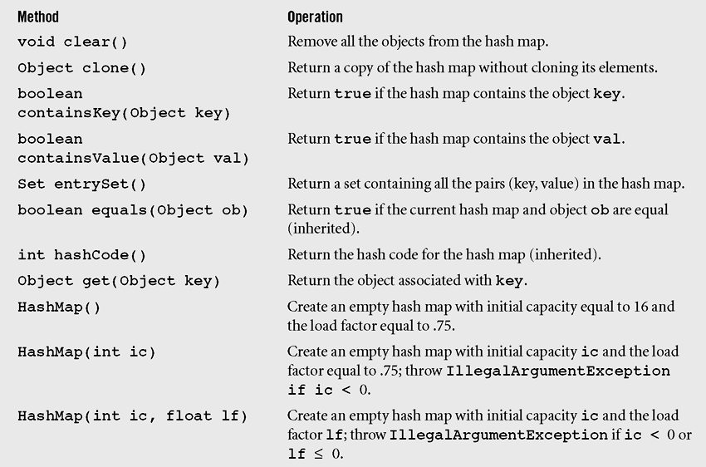
The java.util.HashMap class…
Methods in class HashMap including three inherited methods

Slide 41
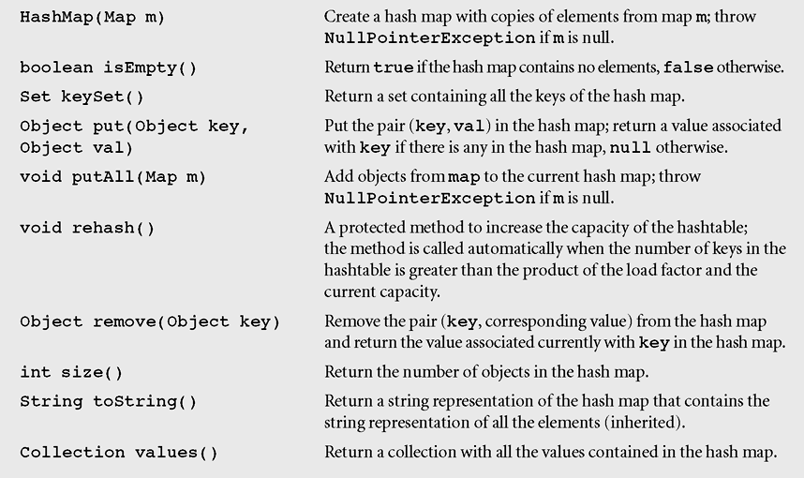
The java.util.HashMap class…
Methods in class HashMap including three inherited methods

Slide 42
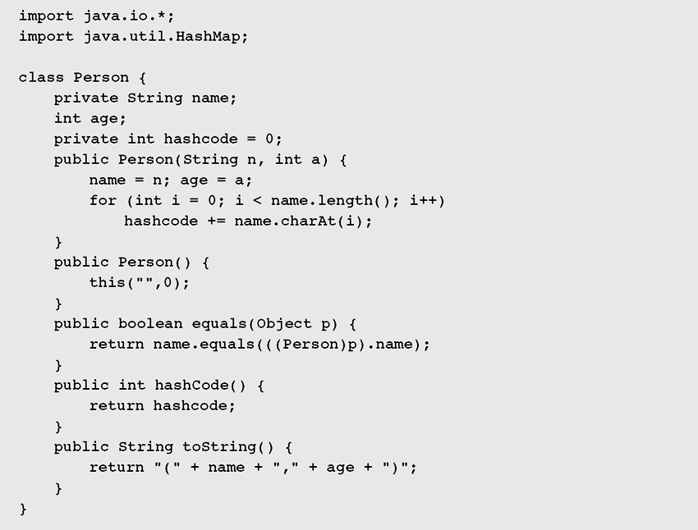
The java.util.HashMap class…
This example (in textbook) demonstates how to use the HashMap class to manage a list of person
< name, age,hashCode> in which the hasCode is the sum of charcter codes in the field name.
Click to go the HashSet class
Figure 10-17 Demonstrating the operation of the methods in class HashMap

Slide 43
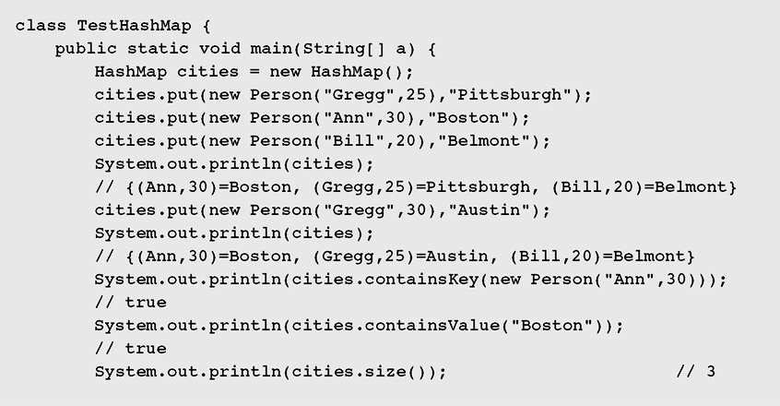
The java.util.HashMap class…
Demonstrating the operation of the methods in class HashMap

Slide 44
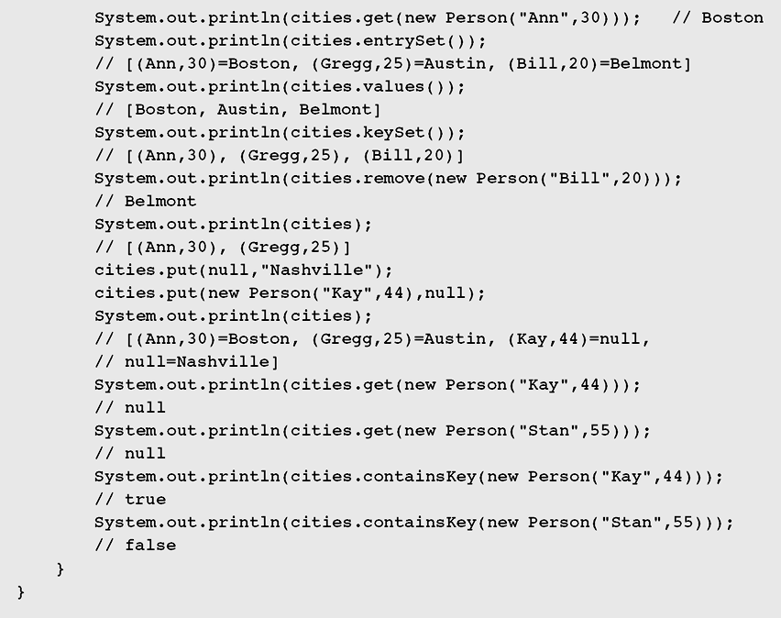
The java.util.HashMap class…
Demonstrating the operation of the methods in class HashMap

Slide 45
The java.utr]il.HashSet class
HashSet is another implementation of a set (an object that stores unique elements)
Class hierarchy in java.util for HashSet is:
Object → AbstractCollection → AbstractSet → HashSet
HashSet is implemented in terms of HashMap
public HashSet() {
map = new HashMap();
}

Slide 46
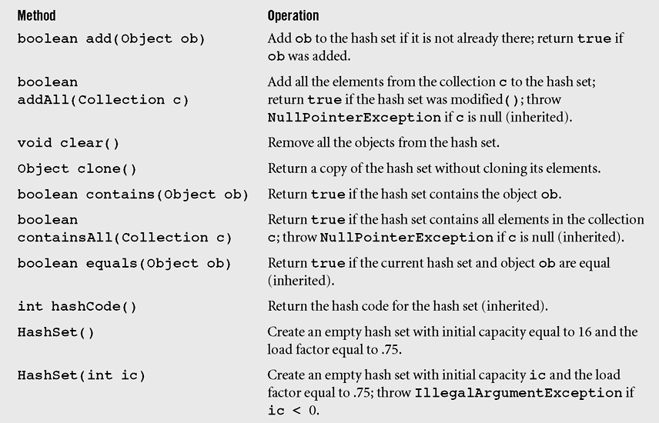
The java.util.HashSet class…
Methods in class HashSet including some inherited methods

Slide 47
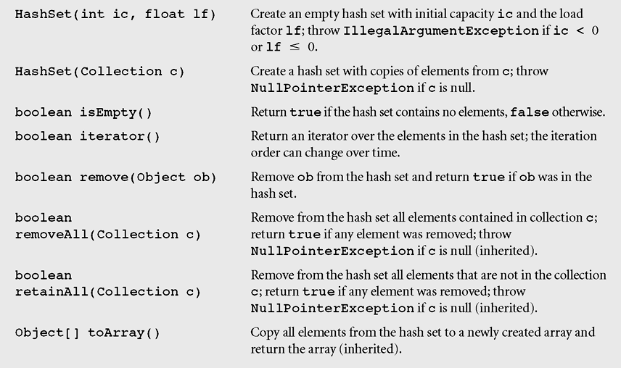
The java.util.HashSet class…
Methods in class HashSet including some inherited methods

Slide 48
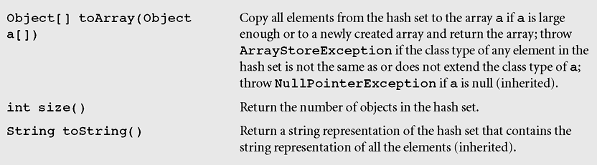
The java.util.HashSet class…
Methods in class HashSet including some inherited methods

Slide 49
The java.util.HashTable
A Hashtable is roughly equivalent (gần tương đương) to a HashMap except that it is synchronized and does not permit null values with methods to operate on hash tables
The class Hashtable is considered a legacy class, just like the class Vector
Class hierarchy in java.util is:
Object → Dictionary → Hashtable

Slide 50
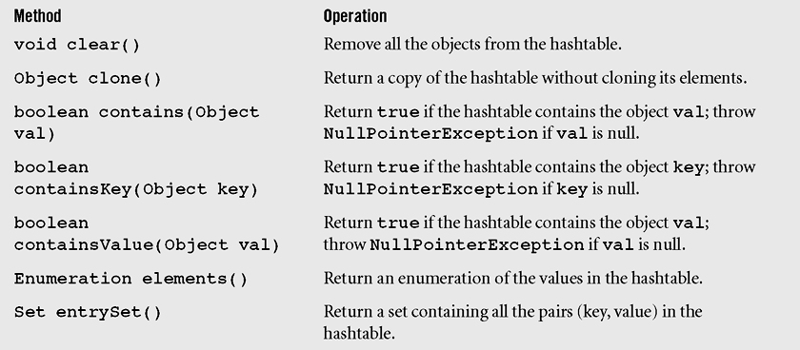
The java.util.Hashtable class…
Figure 10-20 Methods of the class Hashtable including three inherited methods

Slide 51
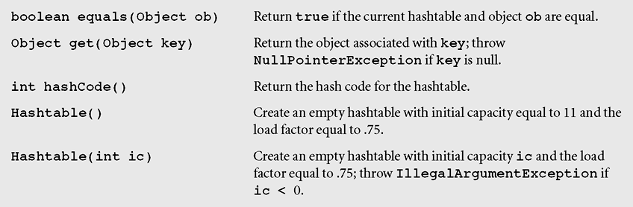
The java.util.Hashtable class…
Figure 10-20 Methods of the class Hashtable including three inherited methods (continued)

Slide 52
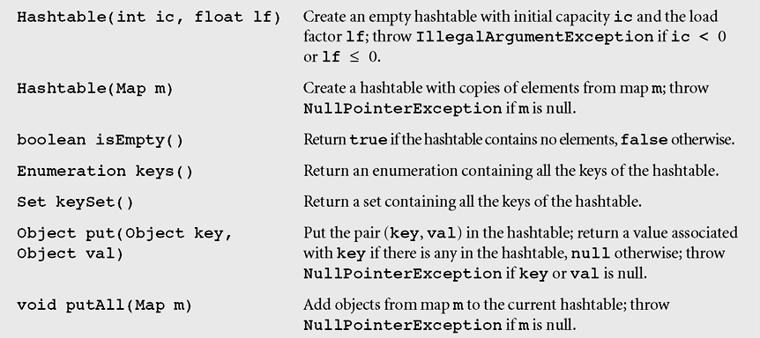
The java.util.Hashtable class…
Figure 10-20 Methods of the class Hashtable including three inherited methods (continued)

Slide 53
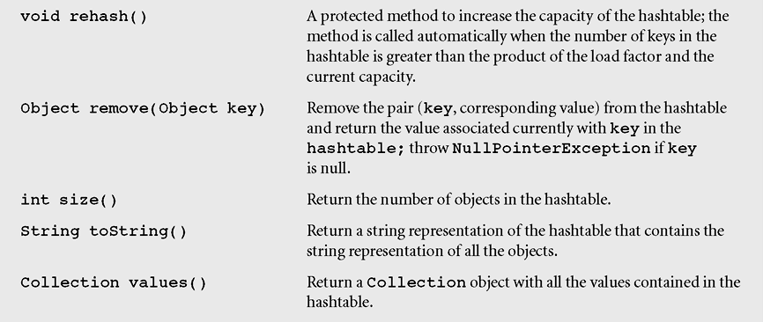
The java.util.Hashtable class…
Figure 10-20 Methods of the class Hashtable including three inherited methods (continued)

Slide 54
Summary: Learning Outcomes

LO7.1 Explain the concept of "hash". Define concepts hash function and hash table and their application.
LO7.2 Demonstrate the types of hash functions: Division, Folding,...
LO7.2 Explain the collision and collision-handling.
LO7.3 Explain the open addressing method for collision-resolution: linear and quadratic probing.
LO7.4 Explain the chaining method for collision-resolution: separate chaining and Coalesced chaining.
LO7.5 Define perfect hash function and extendible hashing.





Slide 55
Summary
Common hash functions include the division, folding, mid-square, extraction and radix transformation methods.
Collision resolution includes the open addressing, chaining, and bucket addressing methods.
Cichelli’s method is an algorithm to construct a minimal perfect hash function

Slide 56
Summary (continued)
The FHCD algorithm searches for a minimal perfect hash function of the form (modulo TSize), where g is the function to be determined by the algorithm
In expandable hashing and dynamic hashing, a binary tree is used as an index of buckets
In extendible hashing, a directory of records is kept in a table

Slide 57
Summary (continued)
A hash map is a collection of singly linked lists (buckets); that is, chaining is used as a collision resolution technique
HashSet is another implementation of a set (an object that stores unique elements)
A Hashtable is roughly equivalent to a HashMap except that it is synchronized and does not permit null values with methods to operate on hash tables

Slide 58
Notices about hash tables
When should hash tables be used:
Elements in a group are different and insertion and search are main operations.
What are things to be concerned before a hash table is implemented?
Choose a key for each element: number/string?
Choose a hash function
Choose a collision resolution
because these things will affect on algorithms that will be chosen in our hash table.

Slide 59
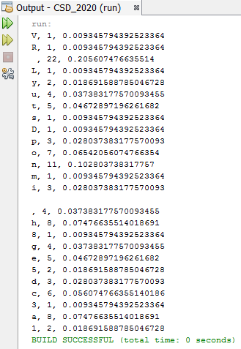
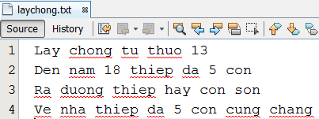
Lab 1: Using HashMap to compute probabilities of characters in a text file

Slide 60
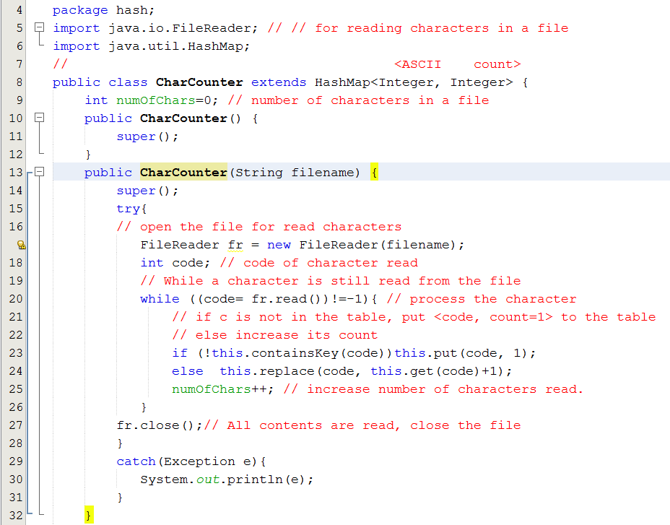
Lab 1: Using HashMap to compute probabilities of characters in a text file

Slide 61
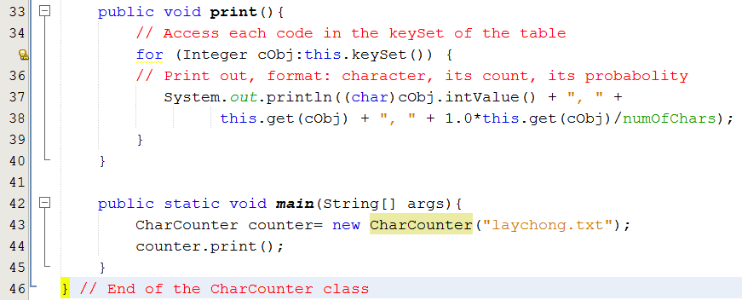
Lab 1: Using HashMap to compute probabilities of characters in a text file

Slide 62
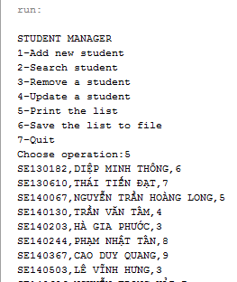
Lab 2: Using HashTable to manage a student list
SE140606,NGUYỄN TRỌNG HẢI,7
SE141127,VÕ TRỌNG ĐẠT,4
SE140913,TRẦN MINH HIẾU,7
SE62440,ĐOÀN LƯƠNG PHÚ,6
SE141153,THÁI ĐỨC THẢO,5
SE140244,PHẠM NHẬT TÂN,8
SE140861,PHẠM ĐĂNG HẢI,5
SE140929,NGUYỄN LÊ ANH LONG,9
SE140755,LÊ ANH DUY,8
SE140618,LÝ GIA HUY,8
SE63394,VŨ VĂN KHẢI,9
SE63391,BÙI LÊ QUỐC THẮNG,4
SE140367,CAO DUY QUANG,9
SE140130,TRẦN VĂN TÂM,4
SE140923,NGUYỄN VĂN TÂN,5
SE130182,DIỆP MINH THÔNG,6
SE140877,NGUYỄN HỒNG SƠN,6
SE140813,NGUYỄN ĐĂNG HUY,6
SE140503,LÊ VĨNH HƯNG,3
SE140874,LÊ HỮU HIẾU,6
SE141086,NGUYỄN MẠNH LỰC,9
SE140873,TÔN THẤT BẢO,4
SE140067,NGUYỄN TRẦN HOÀNG LONG,5
SE140855,TRẦN HOÀNG HẢI DUY,5
SE140885,CAO HOÀNG QUY,7
SE140203,HÀ GIA PHƯỚC,3
SE130610,THÁI TIẾN ĐẠT,7
SE151525,TẠ MINH TIẾN,3

Slide 63
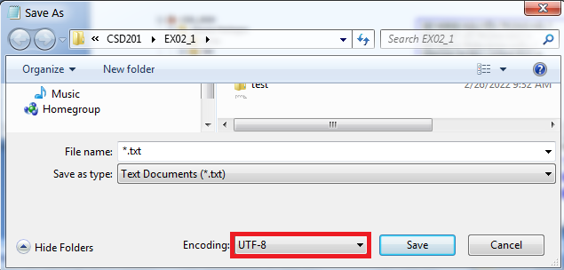
Lab 2: Using HashTable to manage a student list
Use Notepad++/ Wordpad or Netbean editor to edit Unicode text.
Use Notepad to edit Unicode text.

Slide 64
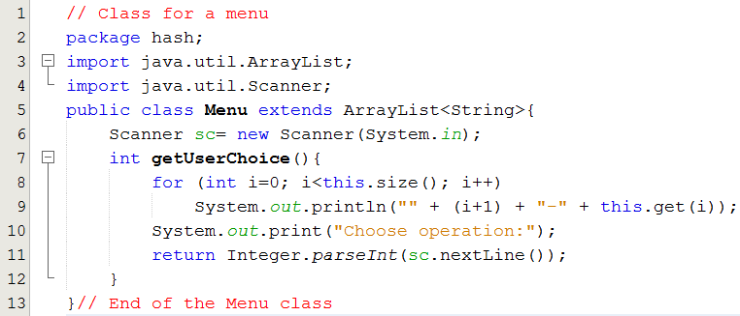
Lab 2: Using HashTable to manage a student list

Slide 65
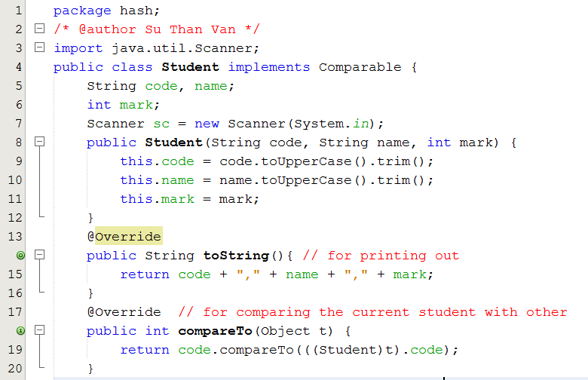
Lab 2: Using HashTable to manage a student list

Slide 66
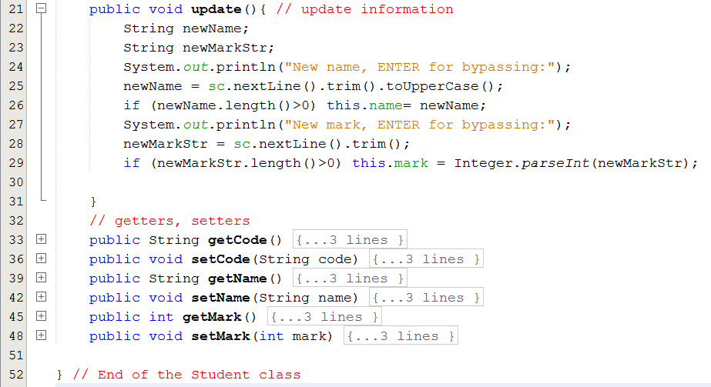
Lab 2: Using HashTable to manage a student list

Slide 67
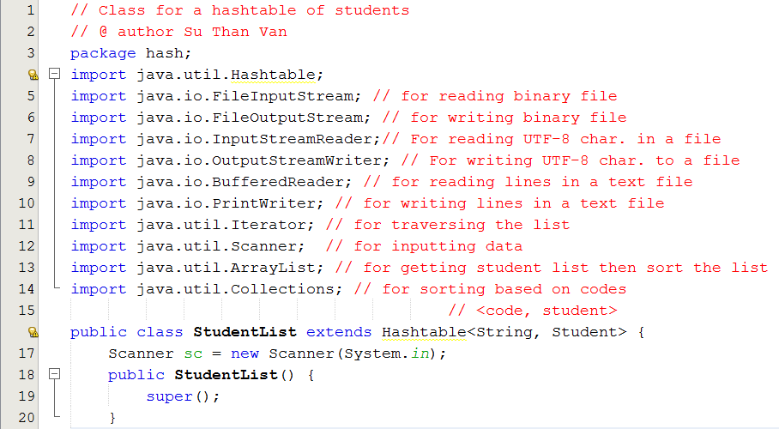
Lab 2: Using HashTable to manage a student list

Slide 68
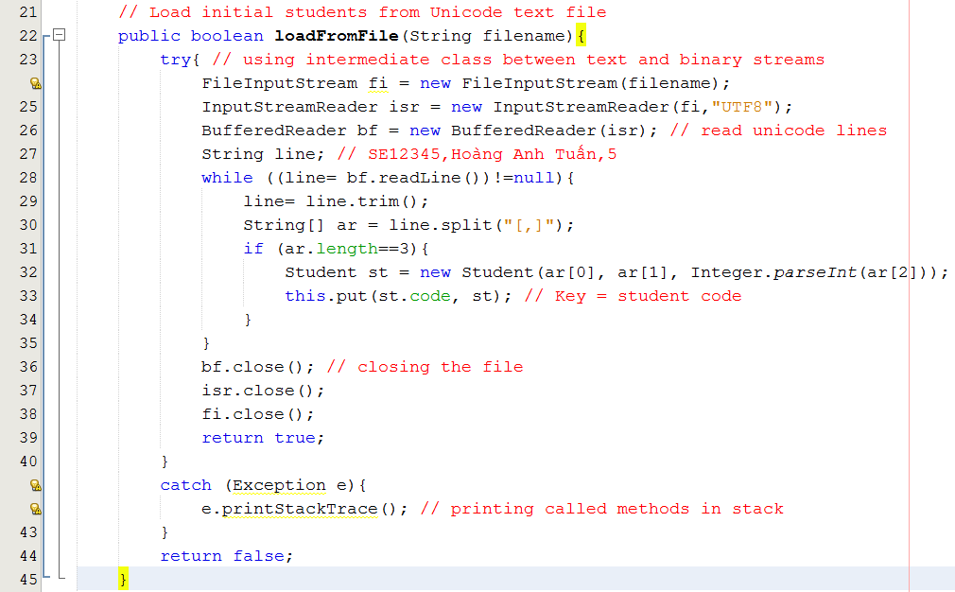
Lab 2: Using HashTable to manage a student list
Char (2 bytes/mem) → nén UTF8 → mã 1 byte → file
Char (2 bytes/mem) ← giải UTF8← mã 1 byte ←file

Slide 69
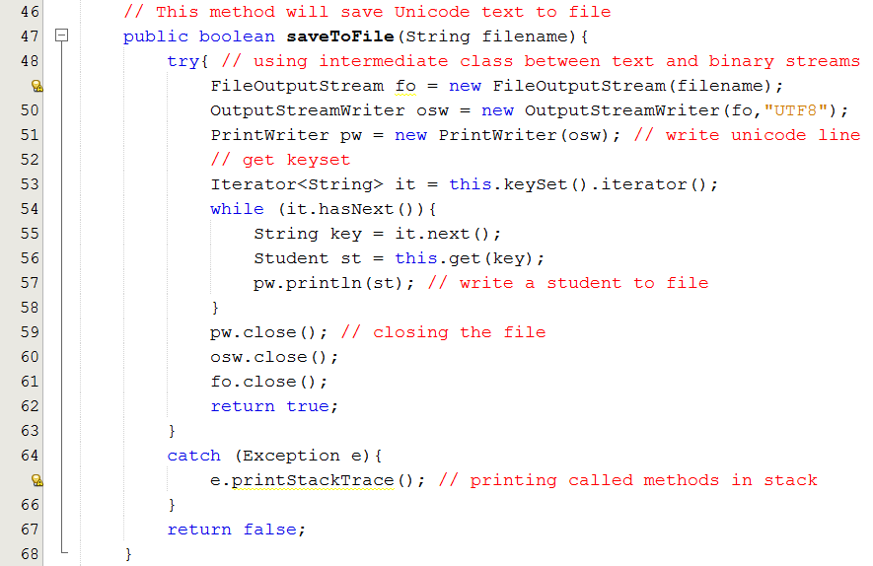
Lab 2: Using HashTable to manage a student list

Slide 70
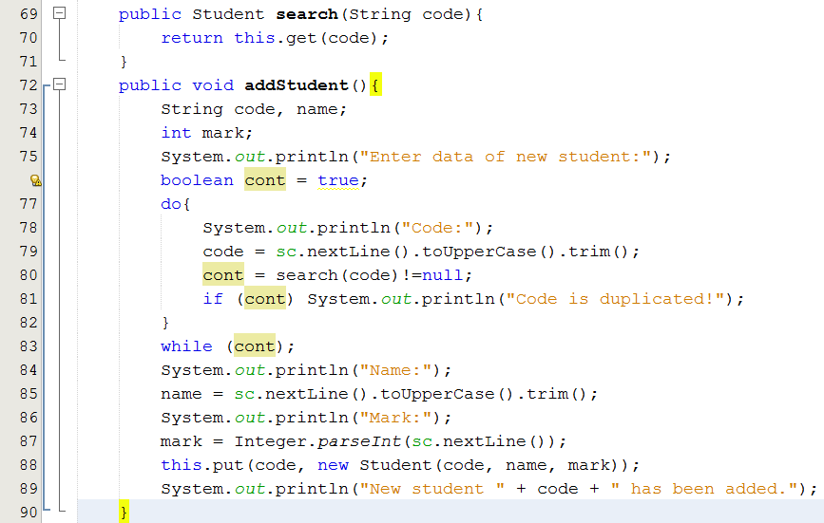
Lab 2: Using HashTable to manage a student list

Slide 71
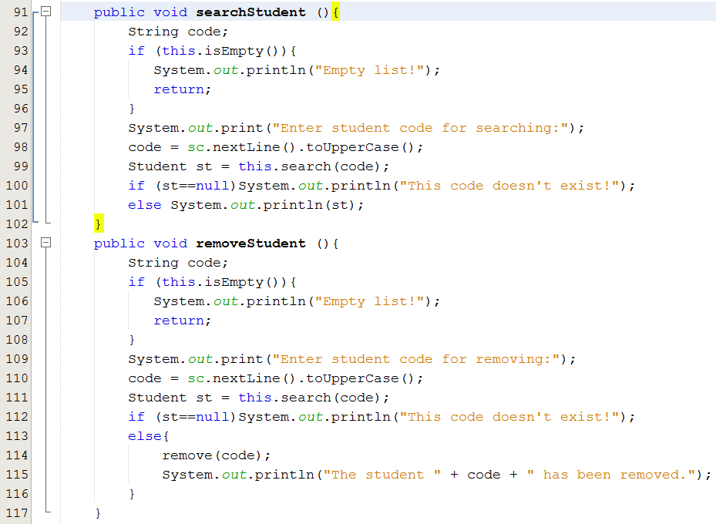
Lab 2: Using HashTable to manage a student list

Slide 72
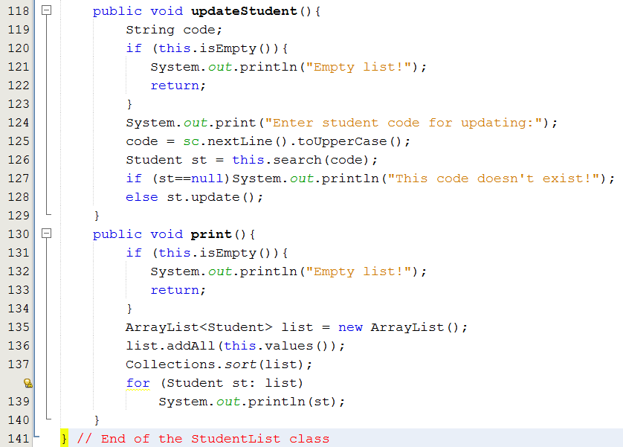
Lab 2: Using HashTable to manage a student list

Slide 73
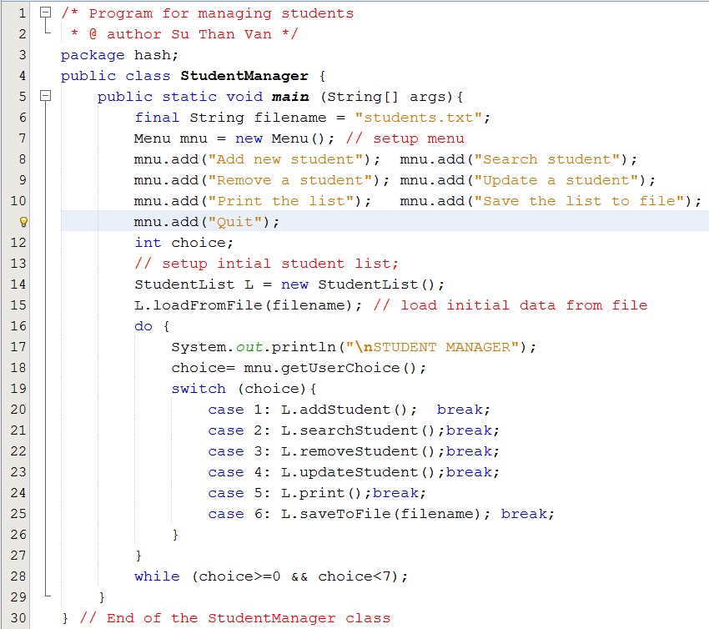
Lab 2: Using HashTable to manage a student list

Slide 74
Bonus: Hashing in Cryptography
Hai nhóm giải thuật:
SHA: Security Hash Algorithms,
MDA: Message Digest Algorithms
Digest, chuỗi bit có độ dài cố định hoặc thay đổi
Hash function
Content
Các cách biến đổi rất cầu kỳ để khó bẻ khóa. Có thể có độn thêm data (gọi là muối, salt)
Hàm băm tốt → ít xung đột
Digest: nội dung tóm tắt
hay chữ ký số
Bên gửi | Bên nhận
Tạo digest từ content Gửi đi (content + digest) | Nhận về (content + digest) Tạo digest2 từ content Nếu (digest2 == digest) thì ontent đáng tin
Áp dụng:
(1) Bảo vệ password trong các database để admin của hệ thống cũng không thể hack.
(2) Tạo tính tin cậy của dữ liệu giao dịch ( kỹ thuật blockchain)

Slide 75
Thank you.

